Slide 1
Country experiences in testing strategies El Salvador
MINISTRY OF HEALTH
ITS/VIH PROGRAM UNIT
CLINICAL LABORATORY OFFICE
AUGUST 2024

Slide 2
Actions to prevent HIV diagnostic errors
Diagnostic Strategy: Use WHO-recommended diagnostic strategies for settings with low (< 5%) and high (≥ 5%) HIV prevalence
Diagnostic Algorithm: Use the diagnostic algorithm validated in the country
Retesting to verify the diagnosis: Before starting ART, verify the HIV diagnosis using a new blood sample and ideally with a different analyst
Test Performance Surveillance: Monitor performance through the PEEC, quality controls, and performance indicators (percentage of concordance and invalid results)
Sistema de gestión de la calidad: adherirse a los 12 fundamentos de la gestión de la calidad incluyendo capacitación y evaluación de los analistas
1
2
3
4
5

Slide 3
Diagnostic Strategy: Use WHO-recommended diagnostic strategies for settings with low (< 5%) and high (≥ 5%) HIV prevalence
Diagnostic Strategy: Use WHO-recommended diagnostic strategies for settings with low (< 5%) and high (≥ 5%) HIV prevalence
Testing Strategy: Generally describes a sequence of tests performed with a specific objective, taking into account the presumed prevalence of HIV infection in the target population of the tests

Slide 4
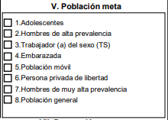
Performance features:
Sensitivity: 99% -100%
Especificity: ≥ 99%
Invalid rate: less than 1%
Therefore:
Test A1 should be the most sensitive test
Test A2 and A3 must have greater specificity
Testing Algorithm: the combination and sequence of specific tests used as part of HIV testing strategies.
Regularly reviewing the testing algorithms—every three, four, or five years—allows for
Ensure that the tests continue to function properly.
Introduce better tests and promote competition among manufacturers.
Conduct validation studies to properly implement algorithms.

Slide 5
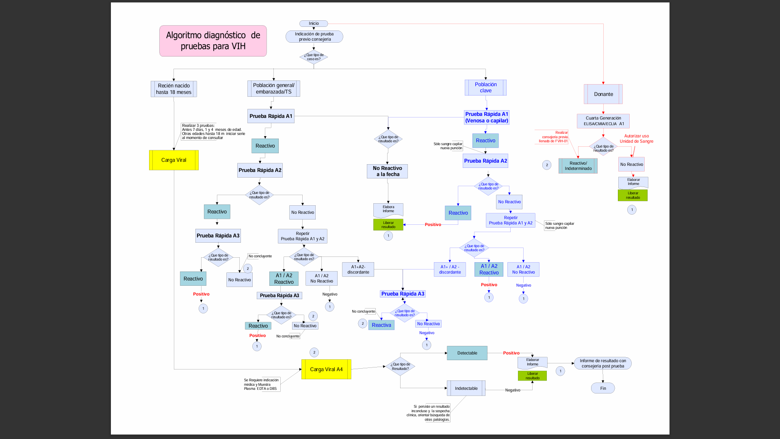

Slide 6
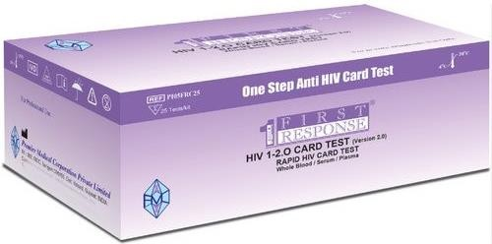
PERFORMANCE CHARACTERISTICS:
Diagnostic algorithm
Use the diagnostic algorithm validated the country
MAIN ALGORITHM HIV RAPID TEST
SEQUENTIAL TEST | SET NAME | SENSITIVITY | SPECIFICATION
A1 | DETERMINE ™ HIV-1/2 | 100% | 99.75%
A2 | BIOLINE™ HIV 1/2 3.0 | 100% | 99.5%
A3 | ABON ™ HIV 1/2/0 | 99.9% | 99.8%
ALTERNATIVE HIV RAPID TEST ALGORITHM
TEST SEQUENTIAL | SET NAME | SENSITIVITY | SPECIFICATION
A1 | DETERMINE ™ HIV-1/2 | 100% | 99.75%
A2 | BIOLINE™ HIV 1/2 3.0 | 100% | 99.5%
A3 | FIRST RESPONSE ®HIV 1 2.O | 100% | 100%

Slide 7
PERFORMANCE CHARACTERISTICS:
Diagnostic algorithm
Use the diagnostic algorithm validated the country
MAIN ALGORITHM DUAL TEST
TEST SEQUENCE | SET NAME | SENSITIVITY | SPECIFICITY
A1 | SD BIOLINE ™ HIV/SYPHILIS DUO BIOLINE ™ HIV/SYPHILIS DUO | HIV: 100%. | 99.5%
A2 | FIRST RESPONSE ® HIV 1-2.O | 100% | 100%
A3 | ABON™ HIV 1/2/O | 99.9% | 99.8%
ALGORITHM ALTERNATIVE, only in case of critical stock-outs
TEST SEQUENCE | SET NAME | SENSITIVITY | SPECIFICITY
A1 | SD BIOLINE ™ HIV/SYPHILIS DUO BIOLINE ™ HIV/SYPHILIS DUO | HIV: 100%. | 99.5%
A2 | BIOLINE™ HIV 1/2 3.0 | 100% | 99.5%
A3 | FIRST RESPONSE ® HIV 1-2.O | 100% | 100%

Slide 8
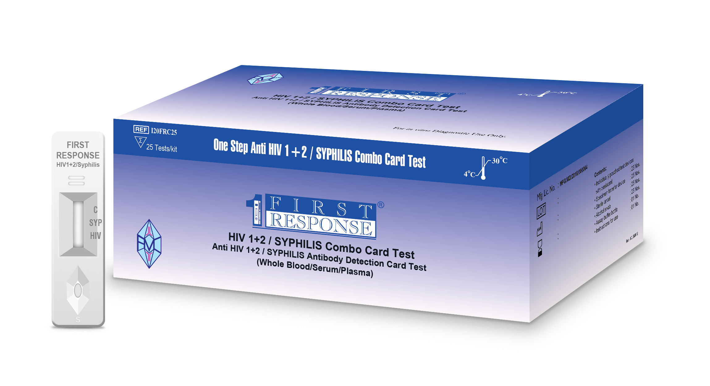
PERFORMANCE CHARACTERISTICS:
Diagnostic algorithm
Use the diagnostic algorithm validated the country
MAIN ALGORITHM DUAL TEST
TEST SEQUENTIAL | SET NAME | SENSITIVITY | SPECIFICITY
A1 | FIRST RESPONSE ® HIV 1+2/SYPHILIS | HIV: 100%. | 99.5%
A2 | BIOLINE™ HIV 1/2 3.0 | 100% | 99.5%
A3 | ABON™ HIV 1/2/O | 100% | 100%
ALGORITHM ALTERNATIVE, only in case of critical shortages
TEST SEQUENTIAL | SET NAME | SENSITIVITY | SPECIFICITY
A1 | FIRST RESPONSE ® HIV 1+2/SYPHILIS | HIV: 100%. | 99.5%
A2 | BIOLINE™ HIV 1/2 3.0 | 100% | 99.5%
A3 | FIRST RESPONSE ® HIV 1-2.O | 100% | 100%
Facilities that currently utilizes dual rapid test algorithm VIH/Siphylis
STI facilities
Friendly facilities
National Hospitals that provide TAR

Slide 9
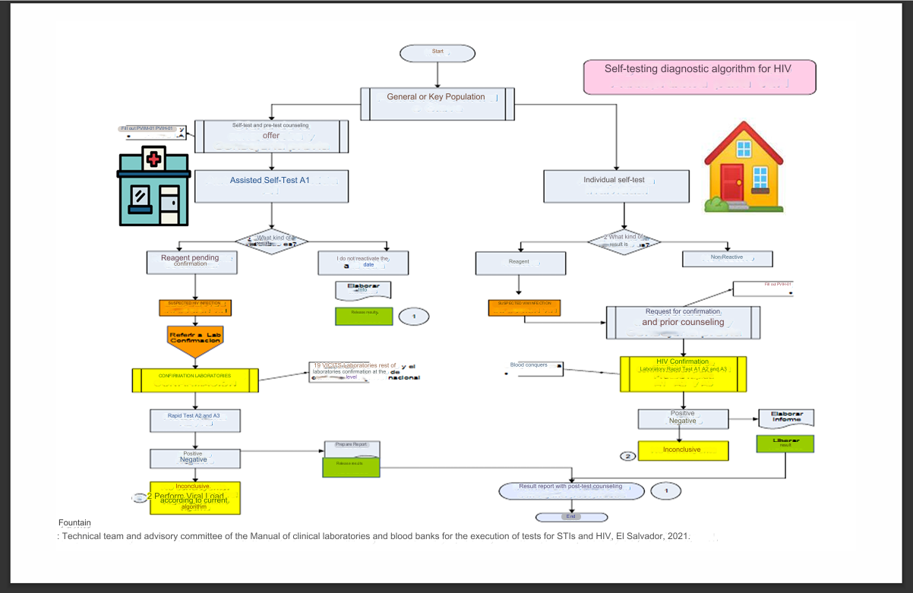
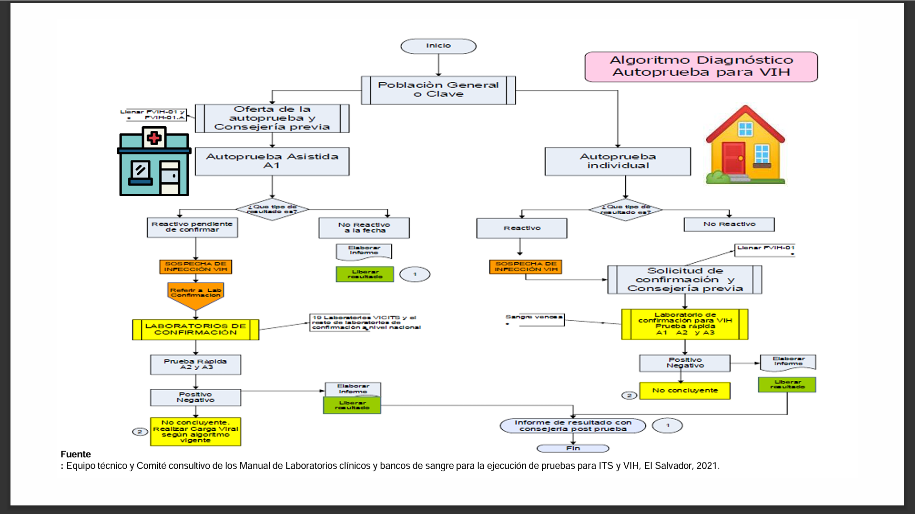
Diagnostic algorithm
Use the diagnostic algorithm validated the country
101 Trained multidisciplinary personnel from 35 facilities in the 5 health regions
SELF-TEST ALGORITHM

Slide 10
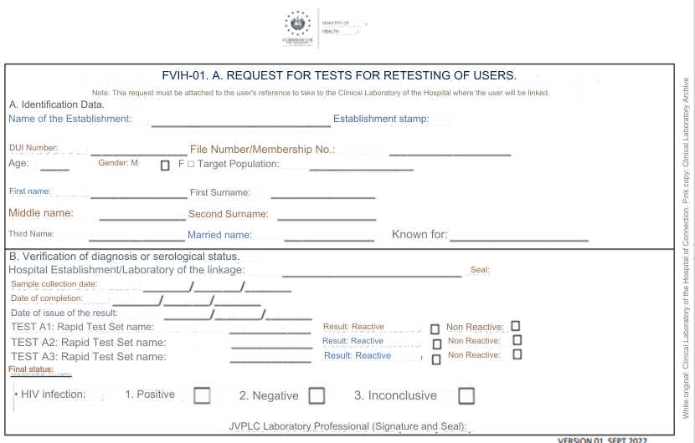
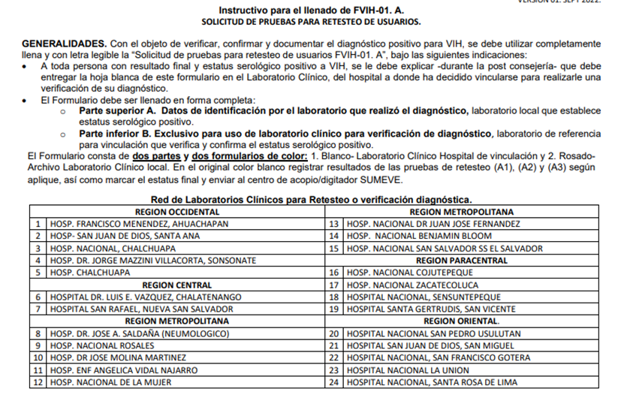
Retesting to verify the diagnosis
Before TAR initiation, verify HIV diagnosis using a new blood sample and, ideally with a different analyst
It is a verification of positive diagnoses before starting antiretroviral treatment
it involves repeating the test using a new sample from the recently diagnosed person
Before starting antiretroviral treatment
It must be performed by a different professional than the one who performed the diagnostics test.
The objective of repeating the test following this procedure is:
Rule out technical or administrative errors
Sample confusion due to misidentification and transcription errors
Random errors inherent to the operator or the test device
This repetition does not exclude diagnostic errors related to a poor choice of testing algorithm or lack of validation

Slide 11
Indirect Quality Control
Post-sale or pre-distribution quality control
Internal quality control (IC)
External Quality Assessment Program (PEEC)
Performance indicators
Quality control of clinical laboratories and blood banks

Slide 12
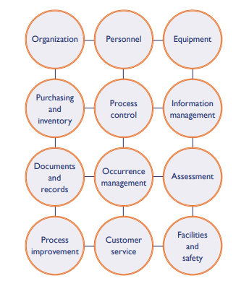
National training program for staff that performs HIV tests, including self-testing
"The coordinated activities to direct and control an organization with respect to quality."
In a quality management system it is necessary to cover all aspects of laboratory operation, including organizational structure and and procedures, to ensure qualityprocesses.
An error in any part of the cycle can lead to a bad lab result.

